Slide 1


Looking Beyond 2020: The Local Perspective on Census Bureau Methods for Estimating the Population
Data Science for the Public Good Seminar
August 1, 2023
Joseph Salvo
Institute Fellow
University of Virginia Biocomplexity Institute

Slide 2



Why Are Population Estimates Important?
Allocating Federal Funds - money for programs and services that contain a population component -- more than 2.8 trillion dollars annually (FY 2021)
Local Planning - foundation for Emergency management, school construction…and our public health response to epidemiological crises
Controls for Surveys – weighting to a universe and post-stratification adjustments to compensate for non-response
Notes:
“Controls” for surveys (e.g., creation of weights and post-stratification adjustments for nonresponse). This includes the American Community Survey (ACS) and the Current Population Survey (CPS), done for the Bureau of Labor Statistics.

Slide 3

Two Methods Used by the Census Bureau
Cohort-Component Method for the Nation, States and Counties
Distributive Housing Unit Method for Sub-county Areas

Slide 4
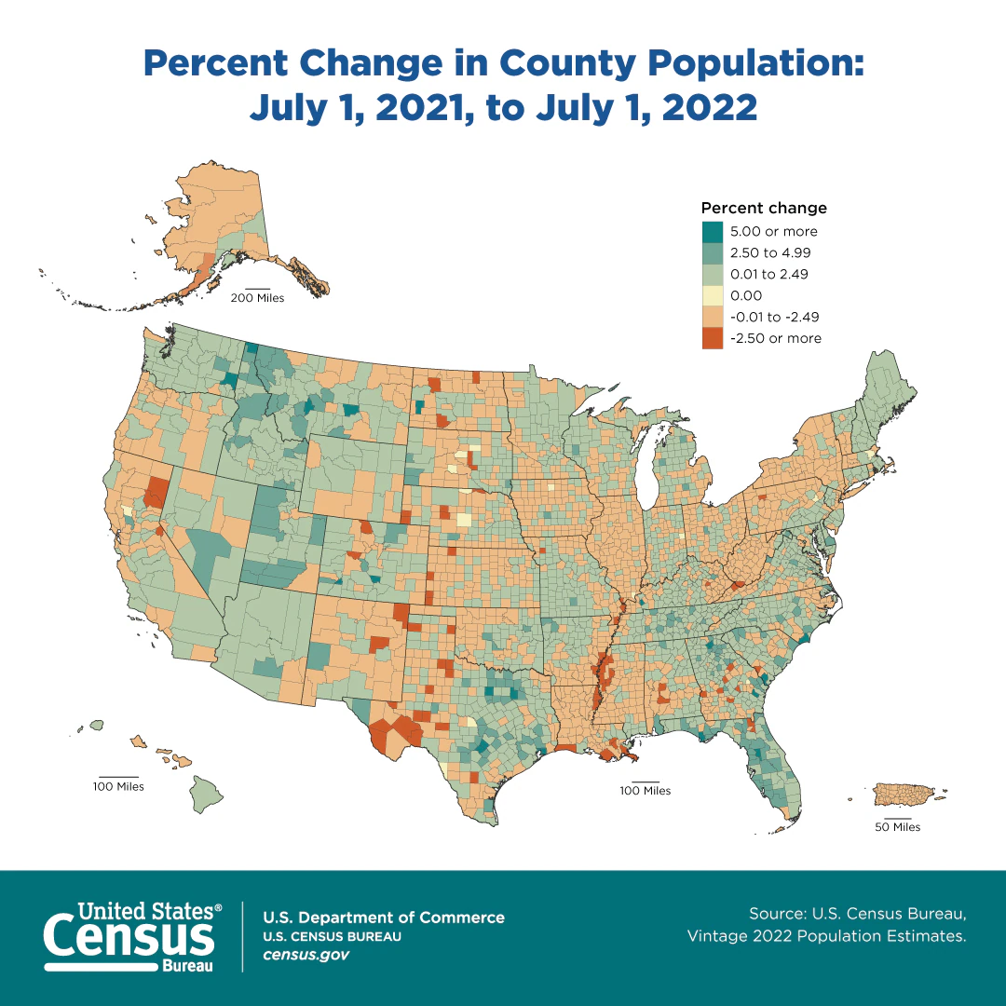
Population Estimates: Counties
Lowest geographic unit for which this method is employed.
Regarded as the best method by the Census Bureau.
All geographic units below the county level must add to county totals.

Slide 5
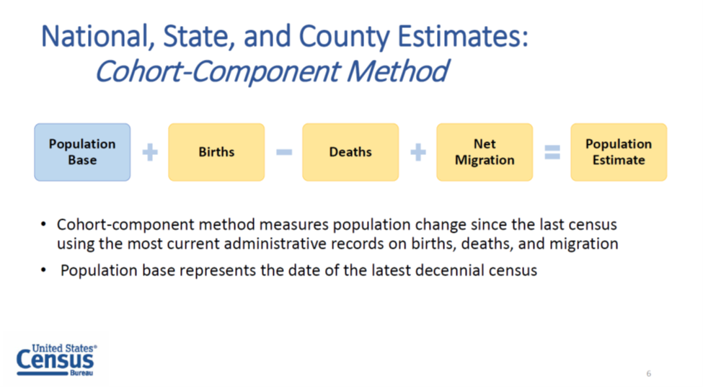
Notes:
Population Estimates Start with a Good Census Count, which we refer to as the Census Base. Estimates are constructed by adding or subtracting the components of population change, using the last census enumeration as a base. “Controls” for surveys (e.g., creation of weights and post-stratification adjustments for nonresponse). This includes the American Community Survey (ACS) and the Current Population Survey (done for the Bureau of Labor Statistics).
The Census Bureau assumes that the population in Group Quarters (GQ) remains constant throughout the decade unless they receive updated data on GQ population change from local sources. Group quarters are defined as places where people live or stay in a group living arrangement that is owned or managed by an organization providing housing and/or services for the residents.

Slide 6
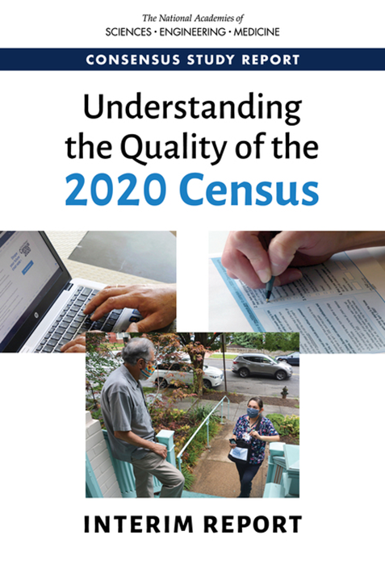
New for the 2020 Census
Given a number of issues with the 2020 Census, including delays in the release of data, the Census Bureau created the “blended base” as the starting point for post-2020 population estimates.
Notes:
The “blended base” (oversimplified) combines information from three sources: the 2020 Census, estimates from Demographic Analysis (DA), and the vintage 2020 population estimates (which use the 2010 Census as a base), to created the age/sex race/Hispanic origin information used as a base for creating intercensal population estimates.

Slide 7
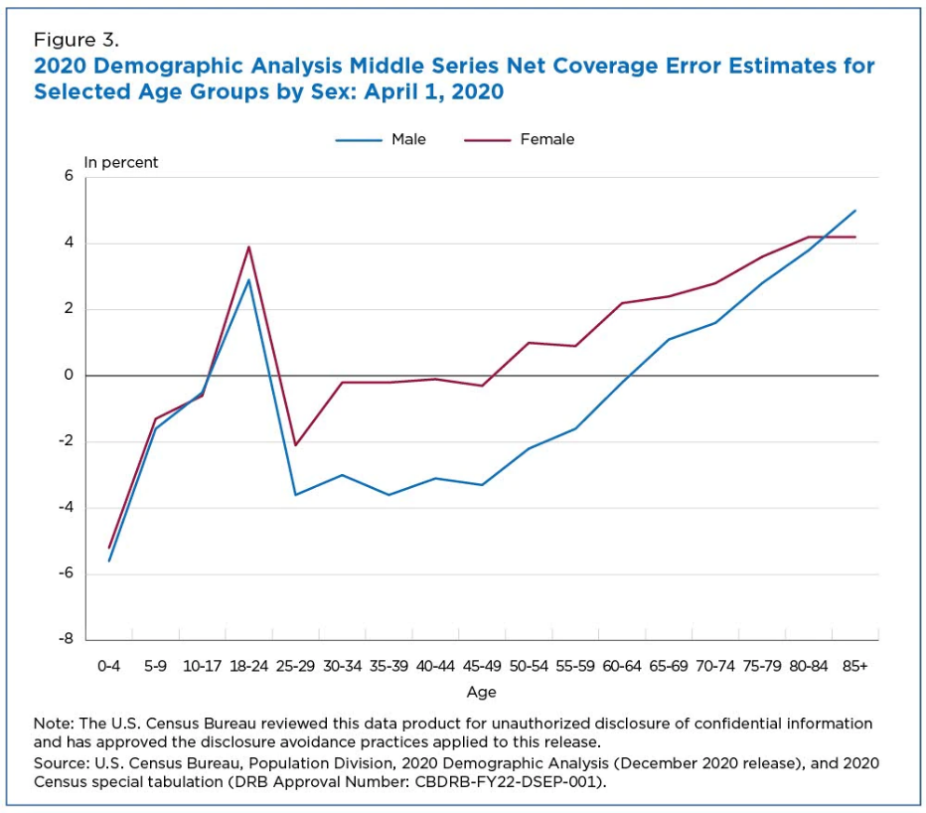
If the census count exactly matched the DA count, all points on the line would be at zero, indicating no difference.
Net undercounts in the census fall below the line, as is the case with those 0-4 years of age
Net overcounts in the census are above the line, as with those 18-24 years and those in the oldest ages.
These Coverage Estimates Were Used to Adjust the 2020 Census Base for Population Estimates

Slide 8
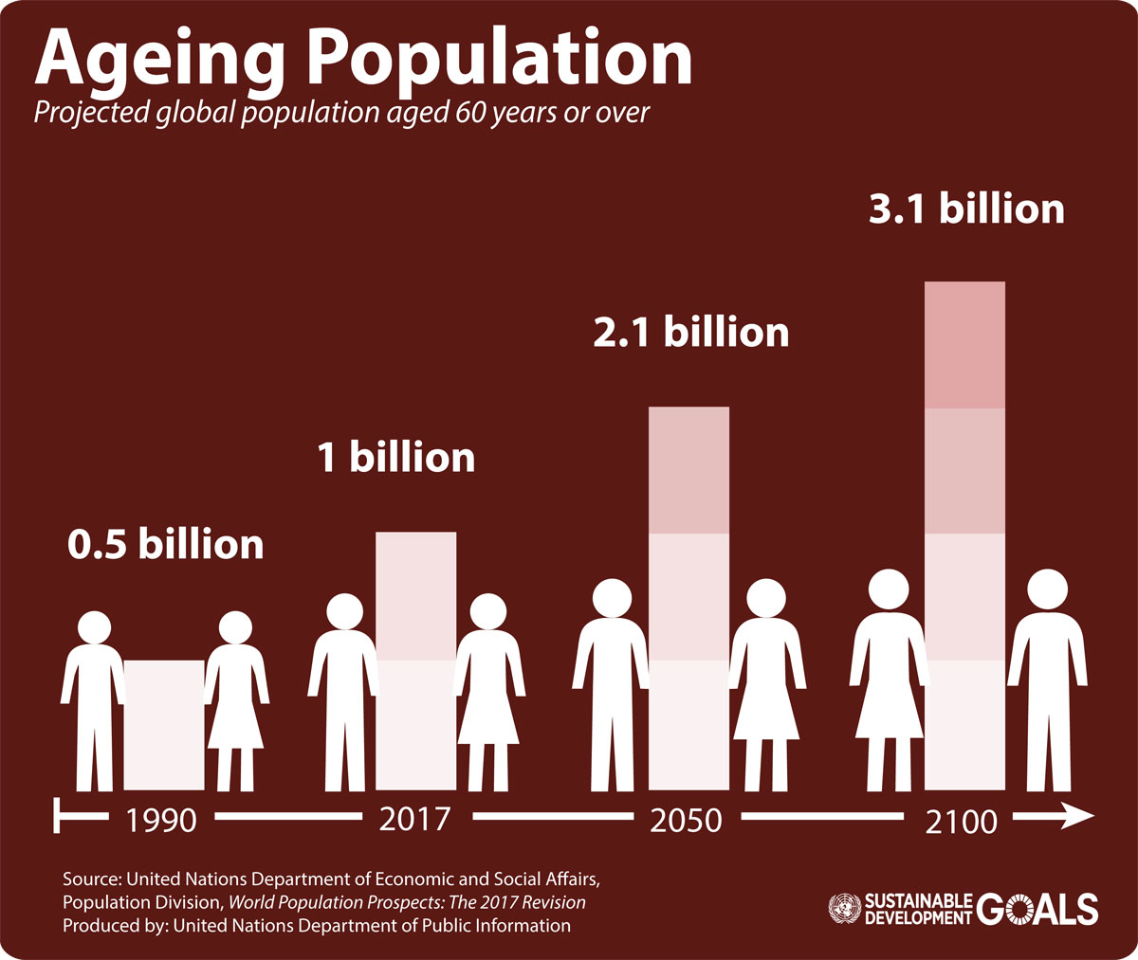
Primary Sources: Natural Increase
Births and Deaths from NCHS* with input from the FSCPE**
Data are time-lagged, with adjustments using provisional data where available.
Missing information on the characteristics of births and deaths is a problem, as is the reporting of deaths for persons 70+ years of age.
*NCHS – National Center for Health Statistics
** Federal-State Cooperative on Population Estimates
Notes:
*NCHS – National Center for Health Statistics
** Federal-State Cooperative on Population Estimates

Slide 9
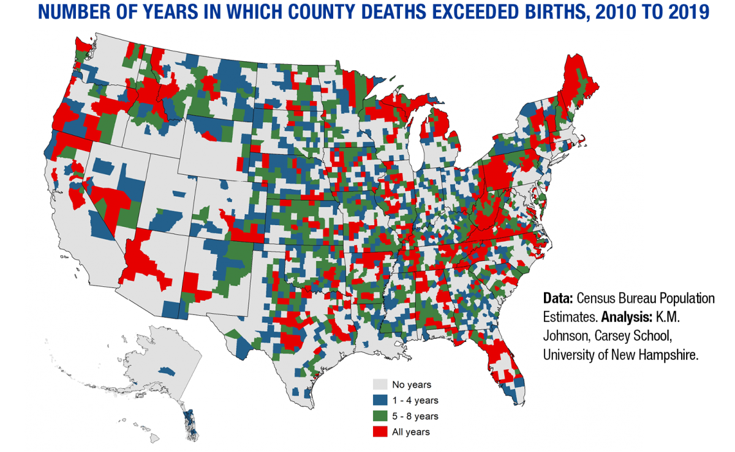

Slide 10
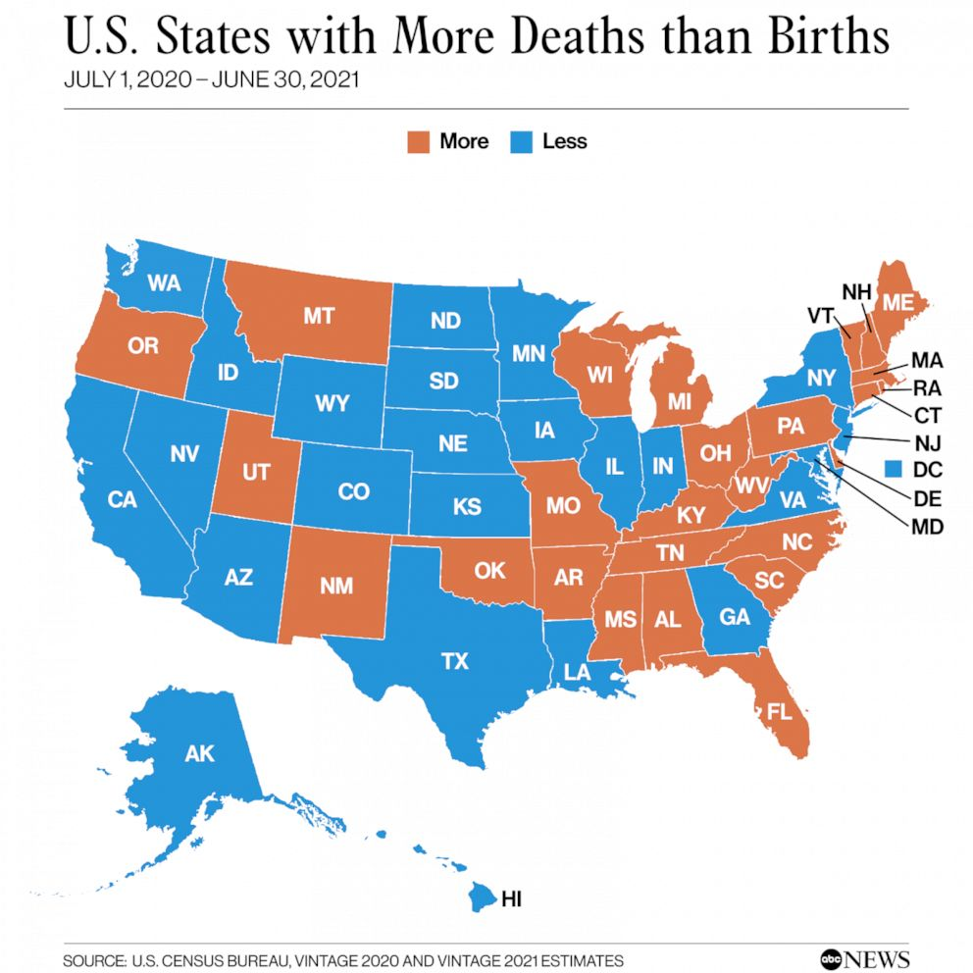

Slide 11
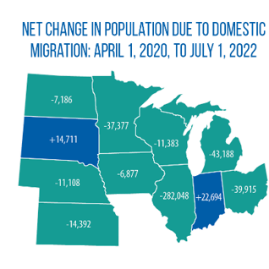
Primary Sources: Net Domestic Migration
Internal Revenue Service (IRS) Tax Returns matched from year to year
Medicare enrollment from the Center for Medicare and Medicaid Services (CMS) for persons 65 and Over
Social Security Administration’s Numerical Identification File – a list of all Social Security numbers ever assigned, updated annually

Slide 12

Primary Sources: Net International Migration
Residence one year ago – Abroad (ACS)
Birthplace and year of arrival (ACS)
Estimates of emigration from the U.S. using death data from NCHS
NUMIDENT database of all Social Security Numbers ever assigned

Slide 13
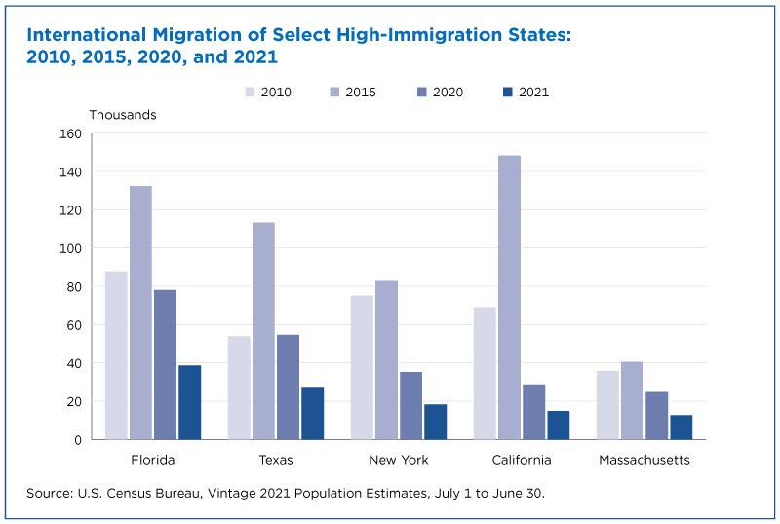

Slide 15
Population Estimates: Subcounty areas
Distributive housing unit method - distribute household population change at the county level based on local change in housing units.
Create ratio of persons per housing unit to create an “uncontrolled” household population.
The “uncontrolled” calculation is done for each subcounty area and then “controlled” to the total for a county.
Notes:
Including Incorporated Places and Minor Civil Divisions
GQ population is held constant from the decennial census base or modified to reflect change based on the same inputs provided for counties, especially input from the FSCPE.

Slide 16
Notes:
Note issues involving permits for new construction and demolition, and certificates of occupancy.

Slide 17
HOUSEHOLD POPULATION ESTIMATES: HOUSING-UNIT METHOD
Using updated housing units, Census creates an “uncontrolled” household population for each Town.
Town A
HUs
2021
Town A
Persons Per Housing Unit
2020
Town A
“Uncontrolled”
Household Population
2021
Chart Courtesy of the Donahue Institute, UMassAmherst
Notes:
Note the absence of a factor to account for housing occupancy/vacancy levels.

Slide 18

A Look into The Future
The intercensal population estimates will continue to be important because they drive funding and local decision-making
There is increasing pressure on the Census Bureau to consider alternate methods, using more locally-relevant data

Slide 19
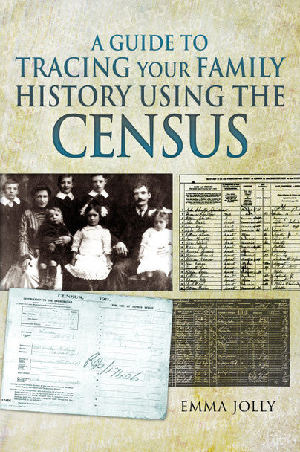

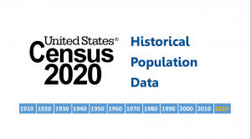
Thank you!

